Slide 1
Institute of Geography and Spatial Planning - University of Lisbon & International Journal of E-Planning Research III International Conference URBAN E-PLANNING Institute of Geography and Spatial Planning, University of Lisbon, Portugal Lisbon, 3 - 4 April 2018
CITY AS SMART AS ITS CITIZENS
NETWORK DATA COLLECTION BY USERS
Luka Mladenovič, Matej Nikšič, Božo Oman, Andrej Zalokar

Slide 2
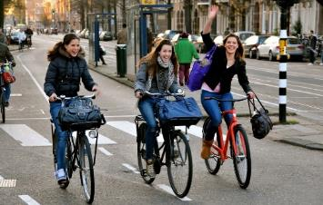
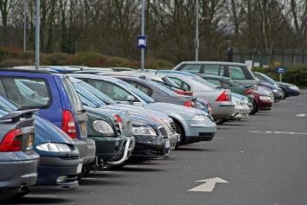
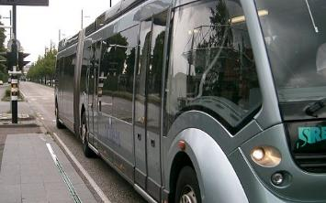
Walking
Planning
Cycling
Motorized traffic
Public transport

Slide 3
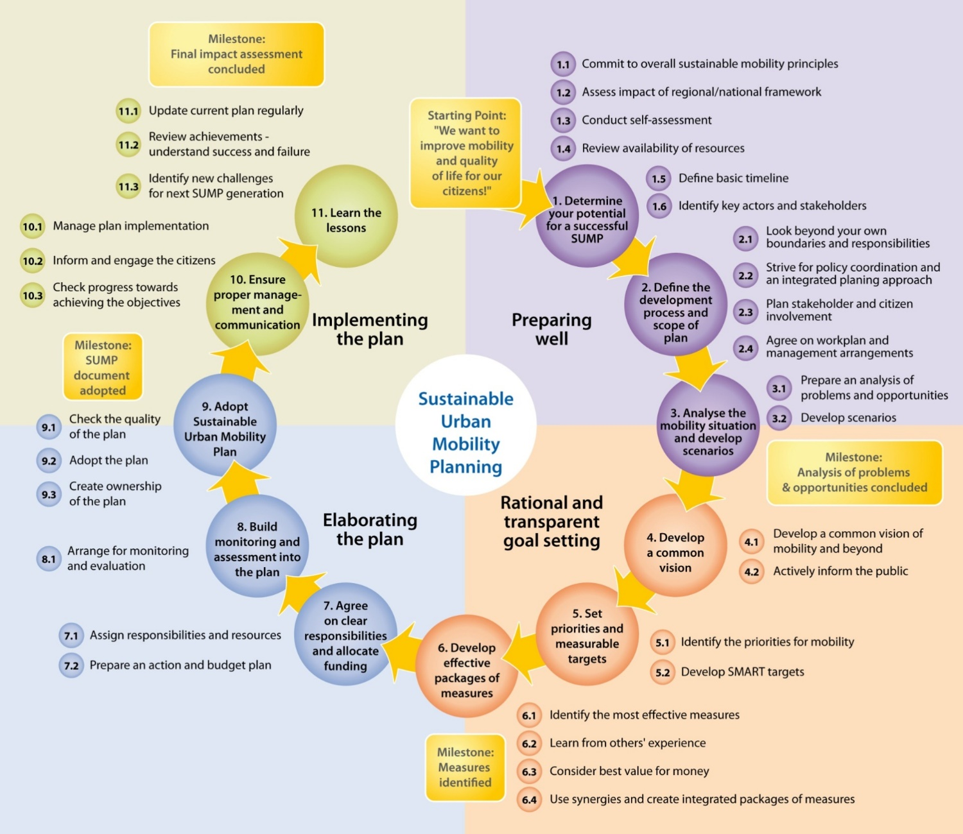
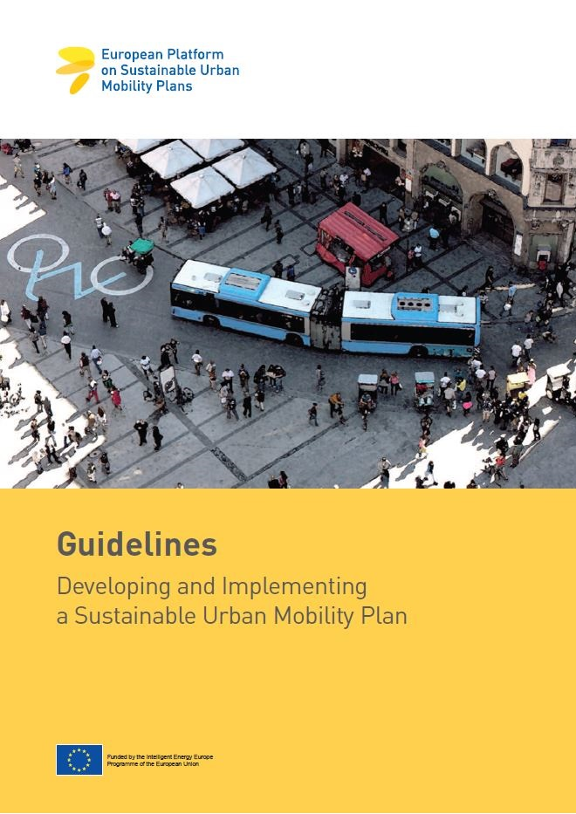
Source: European Platform on Sustainable Urban Mobility Plans
www.eltis.org/mobility-plans
Notes:
In the development (elements 1-9) and implementation (elements 10-11) of an SUMP, the involvement of citizens and other stakeholders is particularly important in the highlighted areas.
Source: http://www.mobilityplans.eu/docs/SUMP_guidelines_web0.pdf
Information for trainers:
You might explain more in depth the Figure 2 (page 15) in the CH4LLENGE brochure on participation.

Slide 4
Type of policy | Communication level |  | Policy message
Closed policy | Public relations (mandatory) | Information | WE DECIDE WHAT‘S GOOD FOR YOU!
Half open policy | Consultation (citizen = customer) | Hearings | TELL US WHAT YOU THINK IS GOOD AND WE WILL TAKE CARE!
Transparent policy | Partnership (responsible citizen) | Various involvement techniques | TOGETHER WE CAN MAKE A DIFFERENCE!
Different policy views on participation
Source: Communication and stakeholder involvement of the new SUMP, Patrick AUWERX, Mobiel 21
Notes:
Nevertheless, it is not only about polical guts…
Visions or policy views on public involvement depend on traditions, culture and political constellationse; e.g. Eastern Europe plan-led countries have other tradition and view compared to Western-Europe countries.
This is not a judgement and certainly not a EU standpoint that SUMP only can benefit from transparant policies. In practise participation varies from situation to situation… Later we will discuss if SUMP is most successful in atmosphere of dialogue

Slide 5
Boyd Cohen (2015) describes the three different generations of smart cities:
Smart Cities 1.0: a technology-centric vision of smart cities led by major technology companies to create efficient and innovation-driven cities
Smart Cities 2.0: a government-led vision of utilizing technologic solutions as enablers for improving quality of life
Smart Cities 3.0: a citizen- or human-centric vision of smart cities based on co-creation [with citizens] to improve quality of life and generate prosperity
Boyd Cohen (2015) The 3 Generations Of Smart Cities

Slide 6
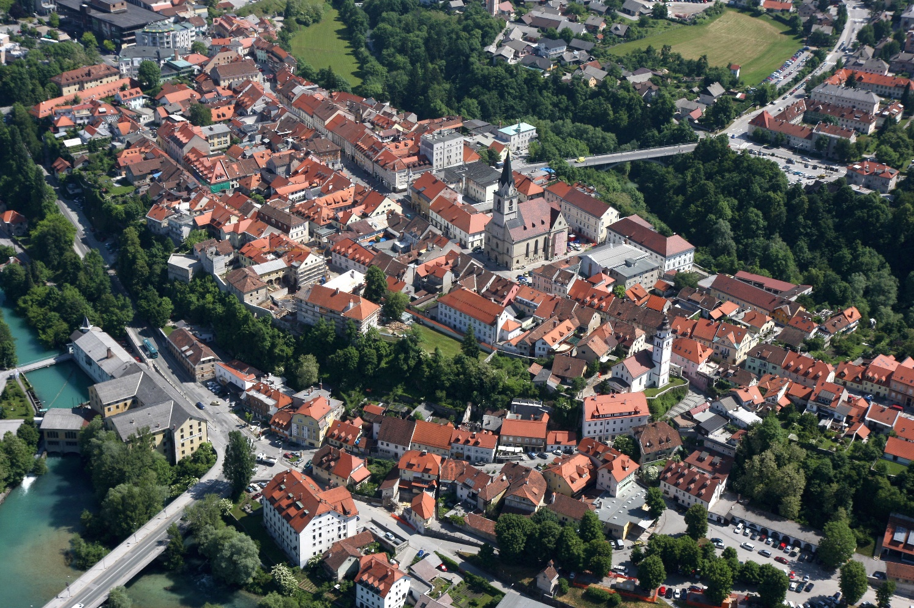
Source: www.kranj.com
Source: www.ge.com

Slide 7
Mayor and City Council
Consulting body
(Comission for safe cycling)
City Administration (departments)
Organized groups
Inhabitants and other users

Slide 8
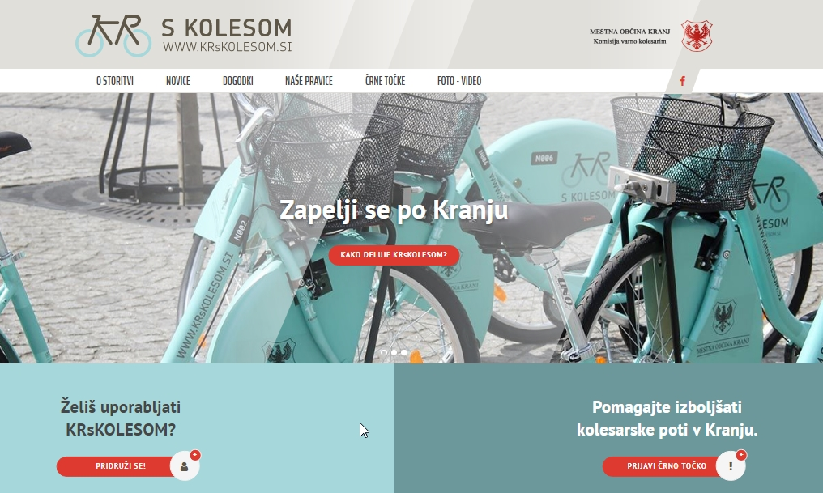
Introduction of the tool for detection of dangerous cycling points

Slide 9
Prcessing protocol:
User: inserts a new problematic point, adds description, photos, etc.
Admininistrator: makes the first assessment for publishing, communicates with user for additional information and the administration regarding possible sollutions, assigns status (not valid, new, in process, fixed), updates status according to external inputs
Comission for safe cycling: prepares regular reports and proposes the priority list

Slide 10
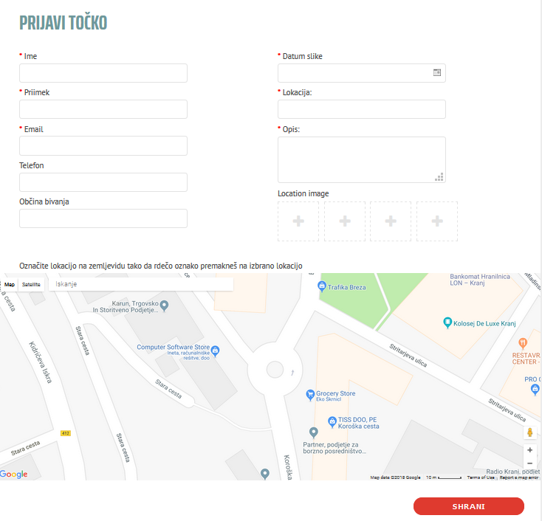
Online form for registration of dangerous cycling points

Slide 11
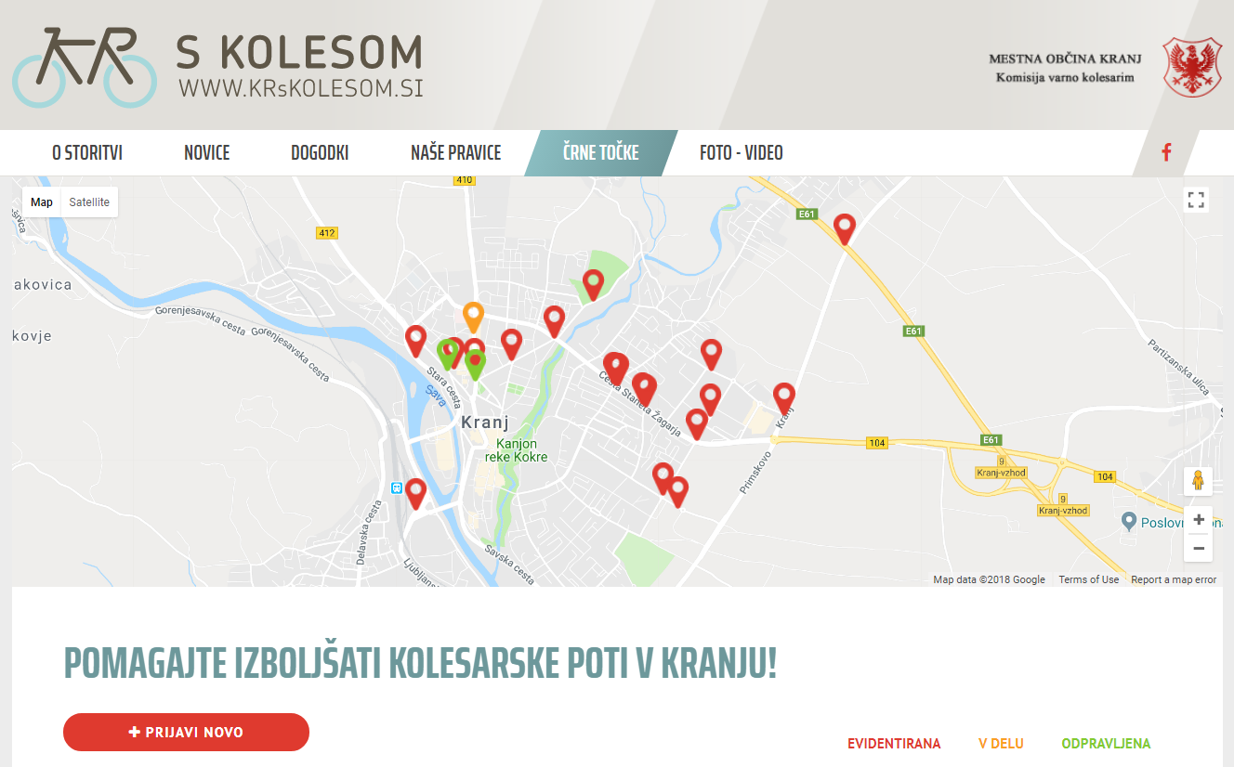

Slide 12
Thank you for your attention
Luka Mladenovič e: luka.mladenovic@uirs.si
Urban Plannig Institute of the Republic of Slovenia
Trnovski pristan 2
p.p. 4717
SI-1127 Ljubljana

